Slide 1


Slide 2

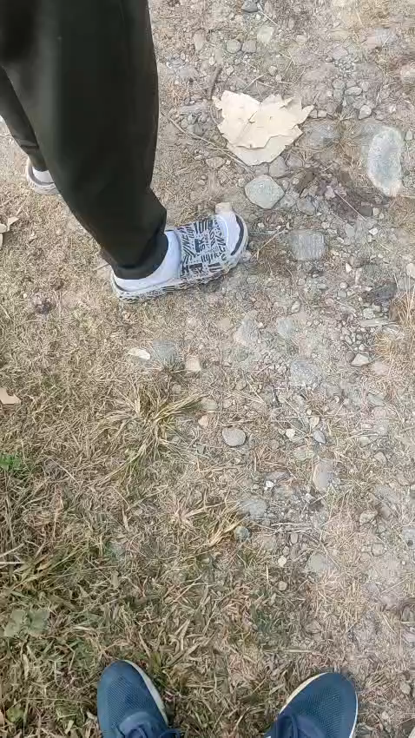
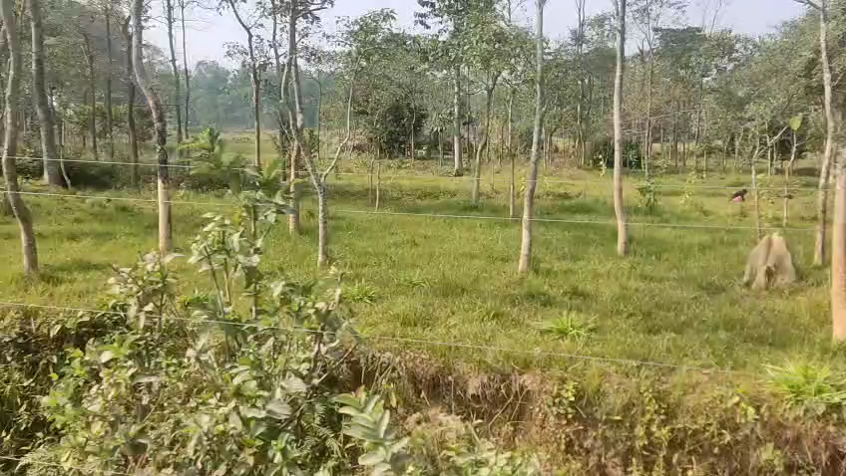
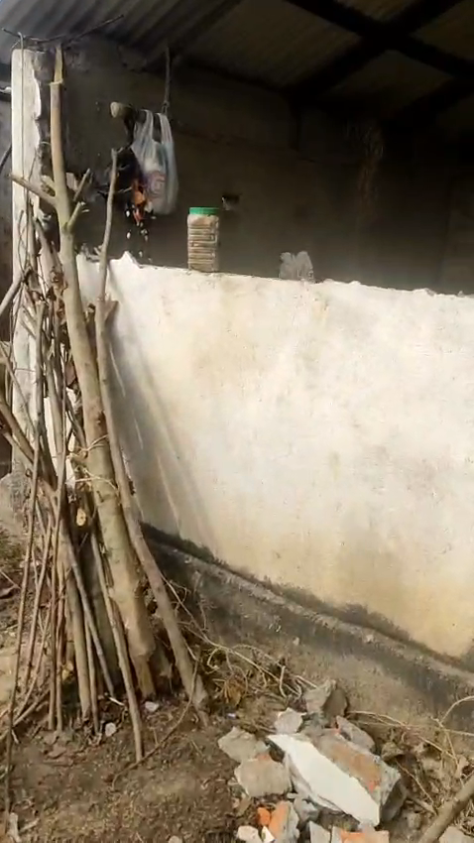
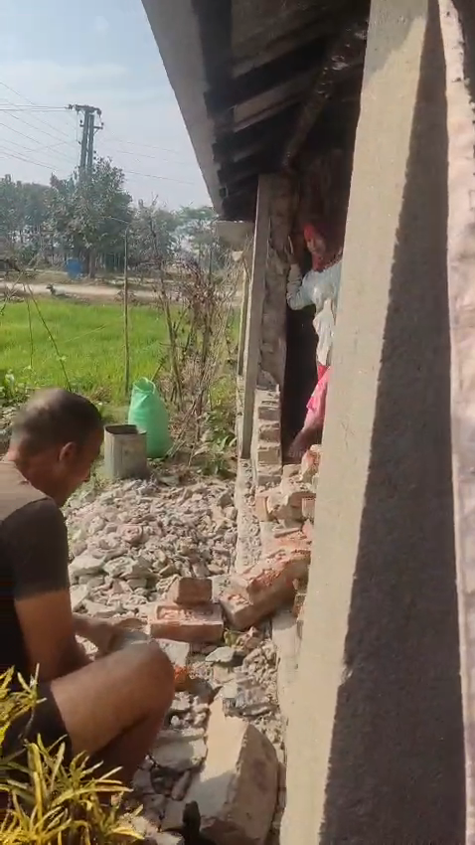
Our Research
The traditional (Electric Fencing) approach
Our team talking with local villagers about problem
House of recently wild elephant attacks.

Slide 3
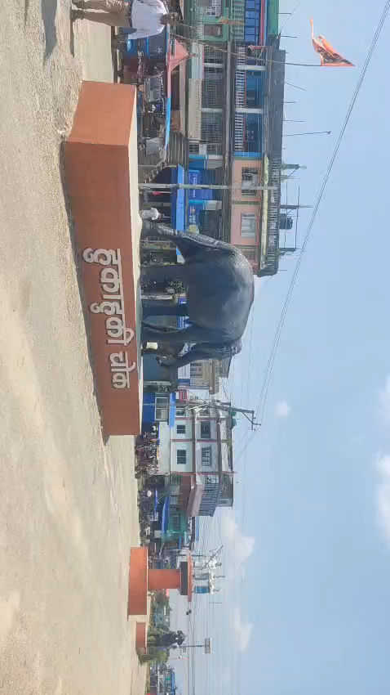

Slide 4
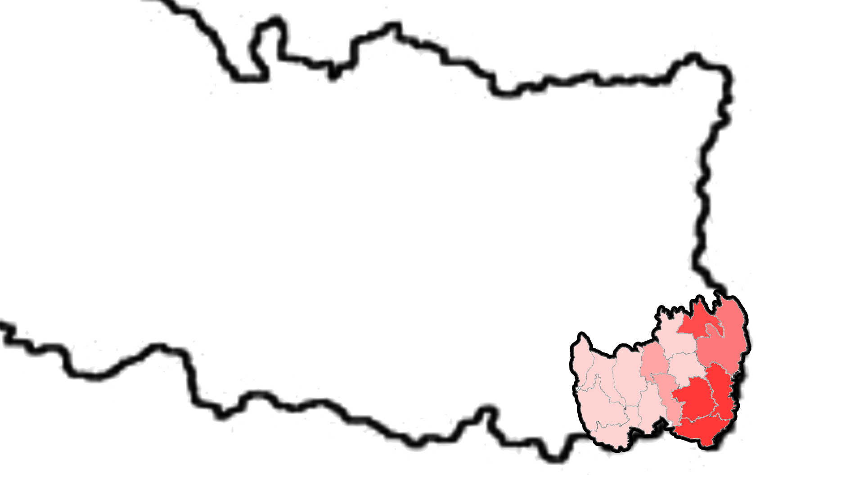
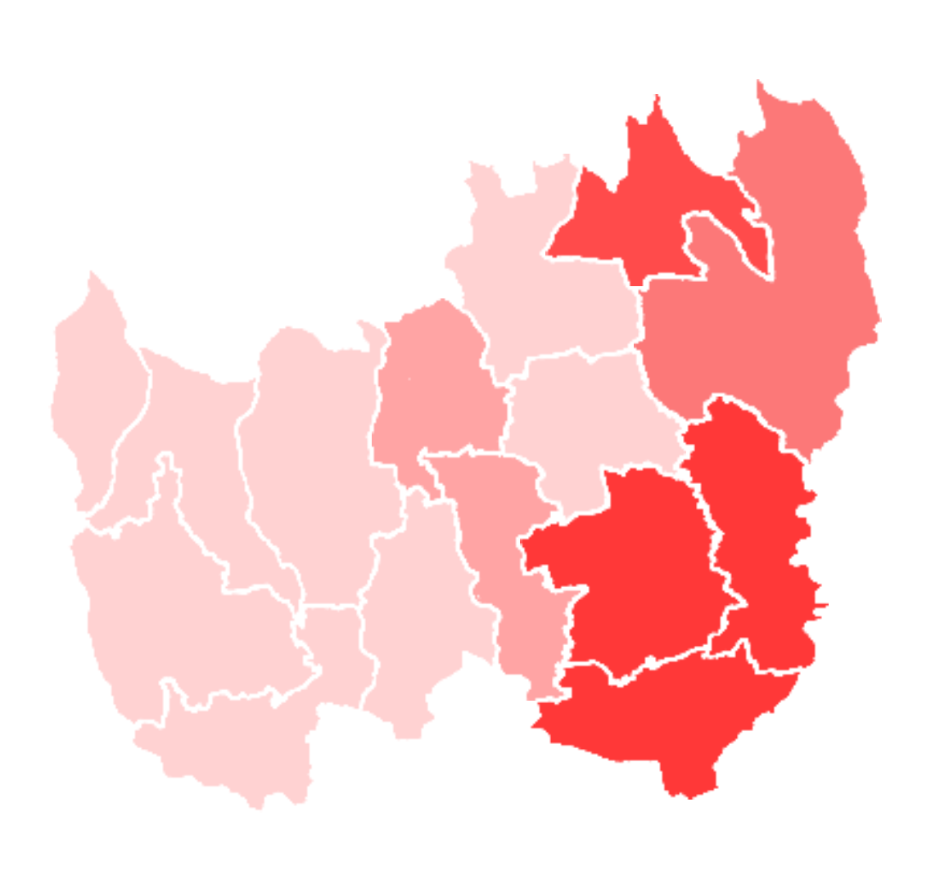
Elephant Prone Area of झापा/Jhapa
Source: https://kathmandupost.com/province-no-1/2023/12/03/elephant-menace-continues-unabated-in-eastern-tarai-districts#:~:text=Wards%206%2C%207%20and%208%20of%20Miklajung%20Rural,Miklajung-8%20are%20the%20hardest%20hit%20by%20the%20elephants

Slide 5
Elephant Prone Area of झापा/Jhapa
Source: https://kathmandupost.com/province-no-1/2023/12/03/elephant-menace-continues-unabated-in-eastern-tarai-districts#:~:text=Wards%206%2C%207%20and%208%20of%20Miklajung%20Rural,Miklajung-8%20are%20the%20hardest%20hit%20by%20the%20elephants

Slide 6
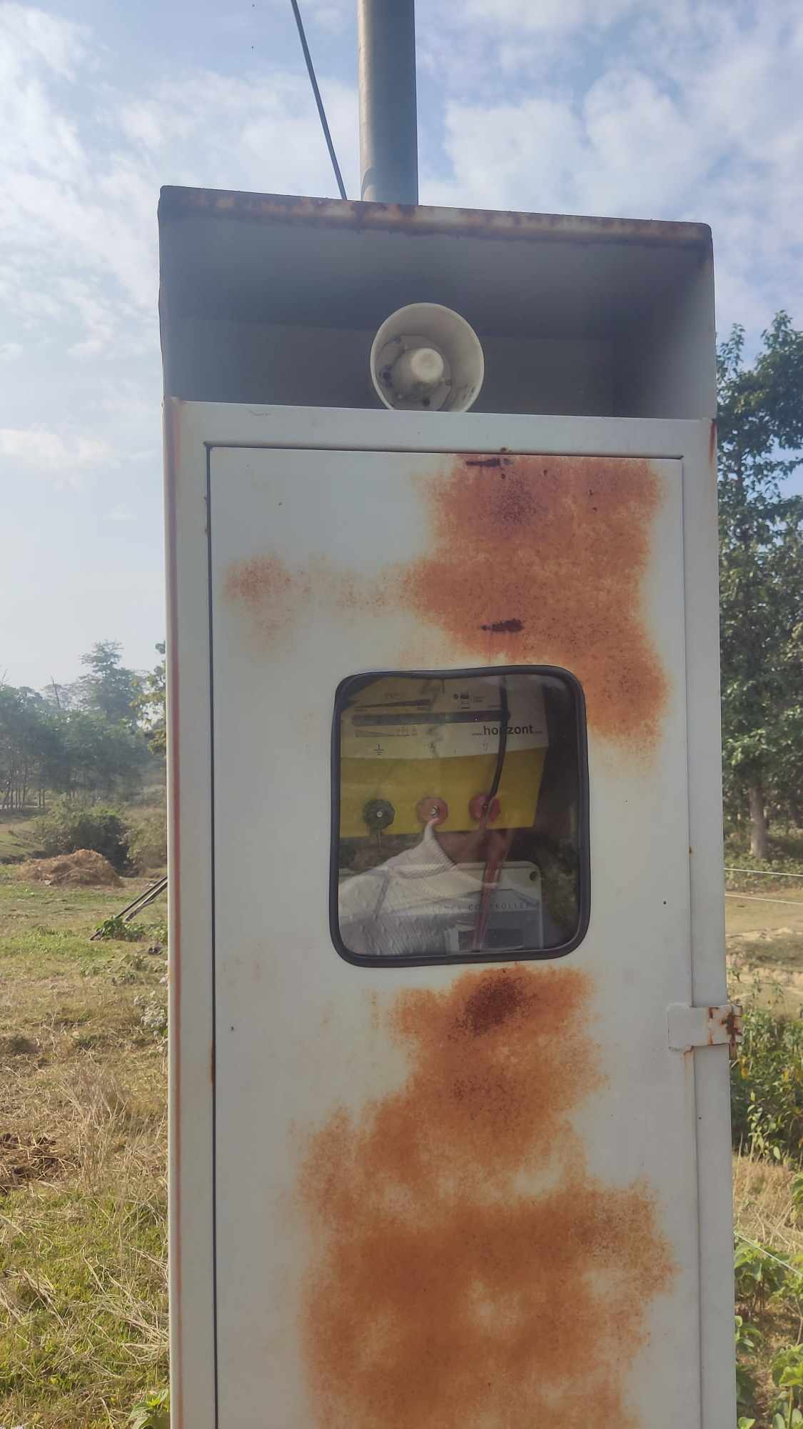
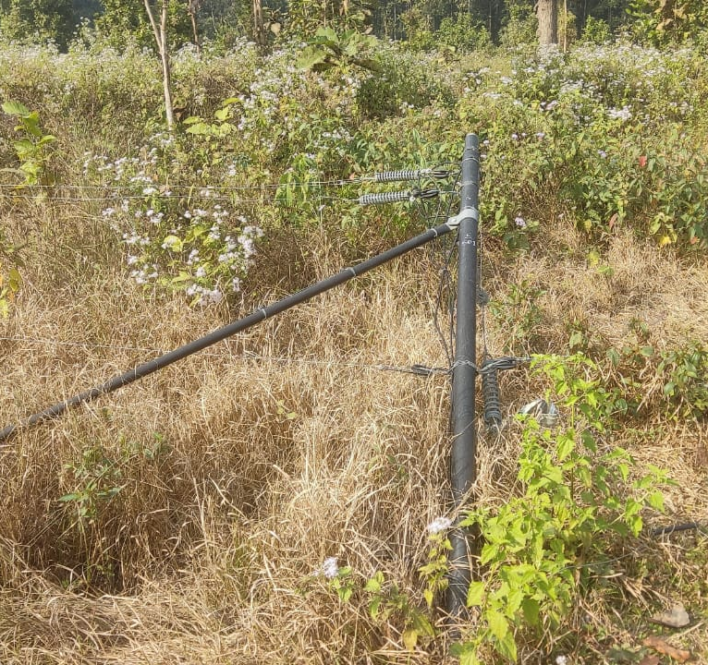
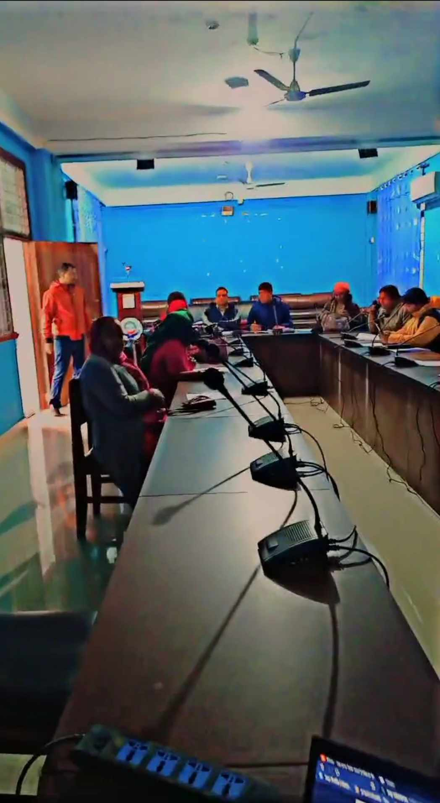
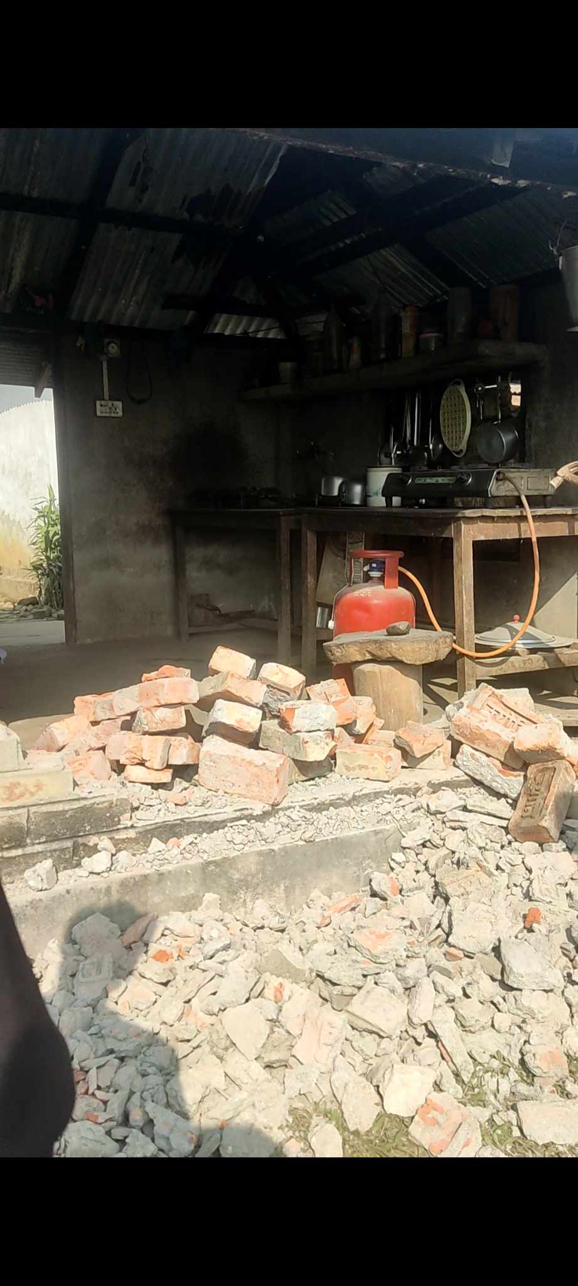
Can our system be realized?

Slide 7
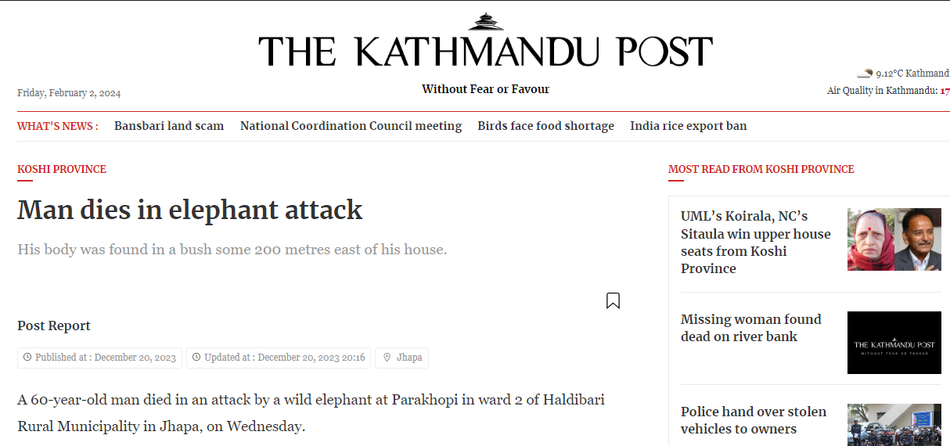
z
z
In last 20 years, At least 274 people have been killed in elephant attacks in Nepal.
Among them, 41 people were killed in Jhapa due to the elephant attack.
https://kathmandupost.com/province-no-1/2023/12/20/man-dies-in-elephant-attack
Source: Research done by Assistant Conservation Officer at January 2022

Slide 8


Slide 9


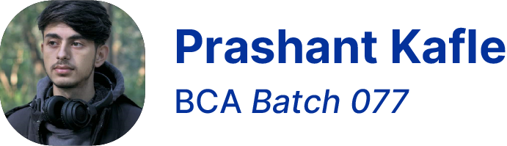
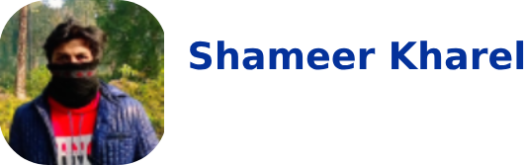


Hello! 👋
We are Mechi Mavericks ⭐
Santosh Bhandari
Sanket Siwakoti
Full Stack Developer
Web/ ML Engineer
Full Stack Developer
AI Engineer

Slide 10

EMCS
Elephant Monitoring & Controlling System

Slide 11


What is EMCS ?
EMCS is a supervising system that looks out for the wild elephant invasion and swiftly alerts the villagers of the incoming danger.
It uses the combination of IOT and ML technologies and works as a unit.
It facilitates authorities to analyze the collected data for future reference.

Slide 12




How Feasible Our System is?
Technical Feasibility
Economical Feasibility
Operational Feasibility
Political Feasibility

Slide 13


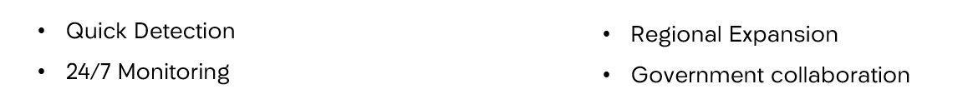


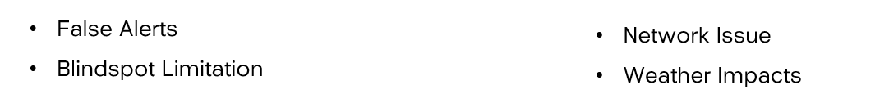
SWOT Analysis .
Strength
Opportunity
Weakness
Threat

Slide 14



Sustainable Development Goals that our project meets
09. Industry, Innovation and Infrastructure
16. Peace, Justice and Strong Institutions
11. Sustainable cities and communities

Slide 15

Market Size
Targeted towards communities and village with a high population and there is a need for such a product due to increasing human-elephant conflicts, the potential market size could be significant.

Slide 16

Business Model
Our platform would be community supported & community oriented. It would not be generating any active revenue. But we will be selling our project as a package, and charge some amount for maintenance.

Slide 17






Technologies used
Following Tech & Development Environments which would be used on our project.

Slide 18
Scalability and future plan.
Integration of new technologies (sensors) for accurate detection
Regional expansion in other affected communities with the success of pilot project
Continuous Data training for mor advance elephant detection model

Slide 19

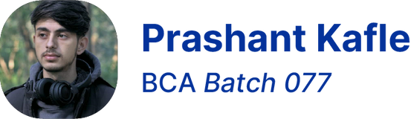

Thank You 🙏
From Mechi Mavericks ⭐
Santosh Bhandari
Sanket Siwakoti
BCA Batch 077
BCA Batch 080
BCA Batch 079

